Slide 1
Chapter 6a:
Application of Newton’s Laws (1)

Slide 2
Learning Objectives
6.1 Solving Problems using Newton’s Laws
6.2 Force of friction

Slide 3
Drawing a Free Body Diagram
Identify all forces acting on the object.
Draw a coordinate system. Use the axes defined in your pictorial representation. If the axes are tilted for motion along an incline, then the axes of the free-body diagram should be similarly tilted.
Represent the object as a dot at the origin of the coordinate axes. This is the particle model.
Draw vectors representing each of the identified forces. Be sure to label each force vector.
Draw and label the net force vector, which points in the same direction as the acceleration vector on your motion diagram.

Slide 4
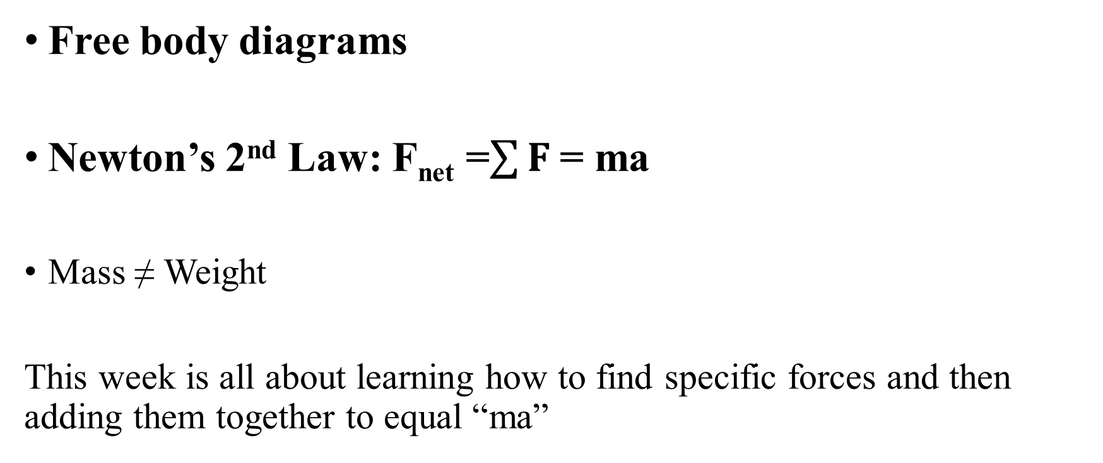
Things to remember…
Free body diagrams
Newton’s 2nd Law: F_{net} =$\sum{F}$= ma
Mass ≠ Weight
This week is all about learning how to find specific forces and then adding them together to equal “ma”

Slide 5









Common Forces and Notations
Force | Notation
General force | Vector F.
Gravitational force | Vector w.
Spring force | Vector F
Tension | Vector T.
Normal force | Vector n.
Static friction | Vector f sub s.
Kinetic friction | Vector f sub k.
Drag | Vector D.
Thrust | Vector F sub thrust.
$\vec{F}$
${\vec{F}}_{g} or \vec{W}$
${\vec{F}}_{s}$
$\vec{T}$
$\vec{N}$
${\vec{f}}_{s}$
${\vec{f}}_{k}$
$\vec{D}$
${\vec{F}}_{thrust}$

Slide 6

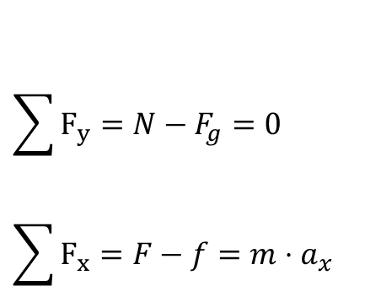
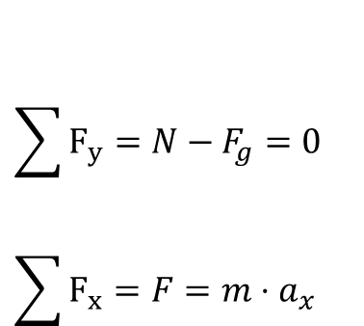
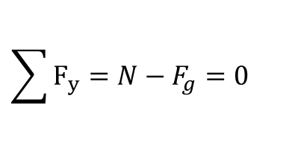
Drawing a Free Body Diagram
DRAW THE FREE-BODY DIAGRAM OF FORCES
N
$$\sum{F_{y}}=N−F_{g}=0$$
$$\sum{F_{y}}=N−F_{g}=0$$
$$\sum{F_{x}}=F=m⋅a_{x}$$
F_{g}
Direction of motion
N
F
no friction
F_{g}
$$\sum{F_{y}}=N−F_{g}=0$$
$$\sum{F_{x}}=F−f=m⋅a_{x}$$
N
Direction of motion
f
F
with friction
F_{g}

Slide 7
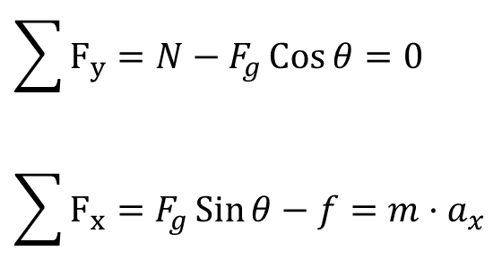
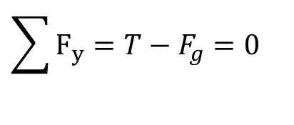
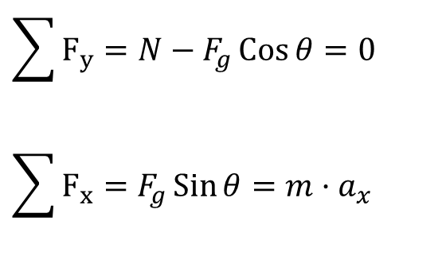
Drawing a Free Body Diagram
DRAW THE FREE-BODY DIAGRAM OF FORCES
T
$$\sum{F_{y}}=T−F_{g}=0$$
F_{g}
Direction of motion
$$\sum{F_{y}}=N−F_{g}\operatorname{Cos}{θ}=0$$
$$\sum{F_{x}}=F_{g}\operatorname{Sin}{θ}=m·a_{x}$$
N
θ
x
θ
NO friction
y
F_{g}
Direction of motion
$$\sum{F_{y}}=N−F_{g}\operatorname{Cos}{θ}=0$$
$$\sum{F_{x}}=F_{g}\operatorname{Sin}{θ−f}=m·a_{x}$$
N
f
θ
x
With friction
y
F_{g}

Slide 8
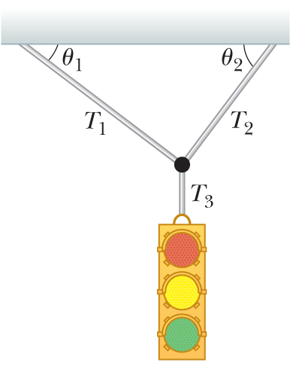
Example: Traffic Light
A traffic light weighing 122 N hangs from a cable tied to two other cables fastened to a support as the figure. The upper cables make angles of θ₁ = 37.0° and θ₂ =53.0° with the horizontal.
These upper cables are not as strong as the vertical cable and will break if the tension in them exceeds 100 N. Does the traffic light remain hanging in this situation, or will one of the cables break?
Notes:
Conceptualize Inspect the drawing. Let us assume the cables do not break and nothing is moving.
Categorize If nothing is moving, no part of the system is accelerating. We can now model the light as a particle in equilibrium on which the net force is zero. Similarly, the net force on the knot that holds the cables together is zero, so it is also modeled as a particle in equilibrium.

Slide 9
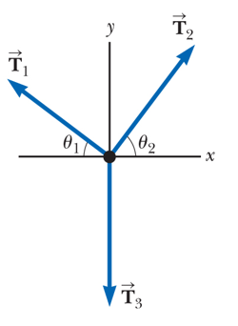










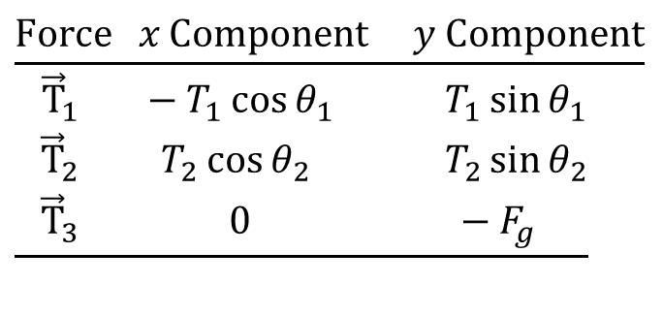

Example: Traffic Light
$$\underline{\text{Force }x\text{ Component }y\text{ Component}} \\ \underline{\begin{matrix} {\vec{T}}_{1} & −T_{1}\cos{θ_{1}} & T_{1}\sin{θ_{1}} \\ {\vec{T}}_{2} & T_{2}\cos{θ_{2}} & T_{2}\sin{θ_{2}} \\ {\vec{T}}_{3} & \text{ 0} & −F_{g}\end{matrix}}$$
Notes:
Analyze We construct a diagram of the forces acting on the traffic light, and a free-body diagram for the knot. This knot is a convenient object to choose because all the forces of interest act along lines passing through the knot.
From the particle in equilibrium model, apply ΣF = 0 for the traffic light in the y direction. [click to show equation]
Choose the coordinate axes as shown in the free-body diagram and resolve the forces acting on the knot into their components. [click to show table]
Apply the particle in equilibrium model to the knot. [click to show equations]
Equation (1) shows that the horizontal components of T₁ and T₂ must be equal in magnitude, and Equation (2) shows that the sum of the vertical components of T₁ and T₂ must balance the downward force T₃, which is equal in magnitude to the weight of the light.

Slide 10
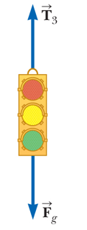

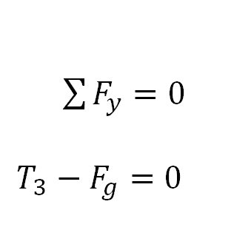
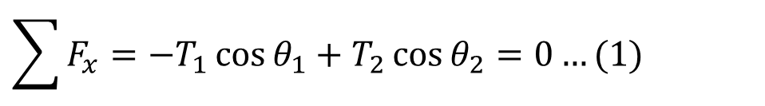
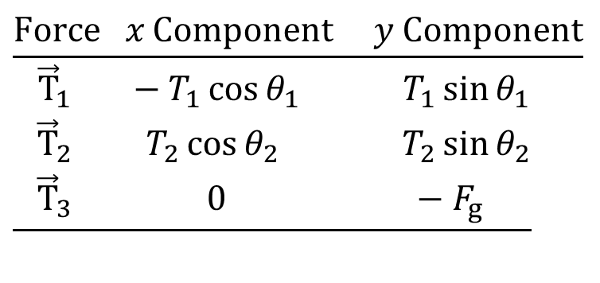
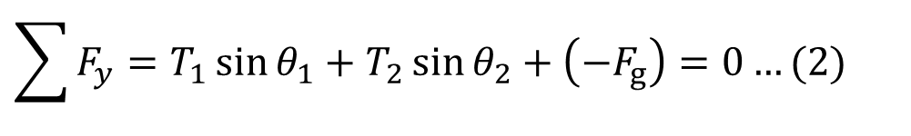
Example: Traffic Light
$$\underline{\text{Force }x\text{ Component }y\text{ Component}} \\ \underline{\begin{matrix} {\vec{T}}_{1} & −T_{1}\cos{θ_{1}} & T_{1}\sin{θ_{1}} \\ {\vec{T}}_{2} & T_{2}\cos{θ_{2}} & T_{2}\sin{θ_{2}} \\ {\vec{T}}_{3} & \text{ 0} & −F_{g}\end{matrix}}$$
$\sum{F_{y}}=0$
$T_{3}−F_{g}=0$
$$\sum{F_{x}}=−T_{1}\cos{θ_{1}}+T_{2}\cos{θ_{2}}=0…(1)$$
$$⇒T_{3}=F_{g}=122N$$
$$\sum{F_{y}}=T_{1}\sin{θ_{1}}+T_{2}\sin{θ_{2}}+\left(−F_{g}\right)=0…(2)$$
Notes:
Analyze We construct a diagram of the forces acting on the traffic light, and a free-body diagram for the knot. This knot is a convenient object to choose because all the forces of interest act along lines passing through the knot.
From the particle in equilibrium model, apply ΣF = 0 for the traffic light in the y direction. [click to show equation]
Choose the coordinate axes as shown in the free-body diagram and resolve the forces acting on the knot into their components. [click to show table]
Apply the particle in equilibrium model to the knot. [click to show equations]
Equation (1) shows that the horizontal components of T₁ and T₂ must be equal in magnitude, and Equation (2) shows that the sum of the vertical components of T₁ and T₂ must balance the downward force T₃, which is equal in magnitude to the weight of the light.

Slide 11
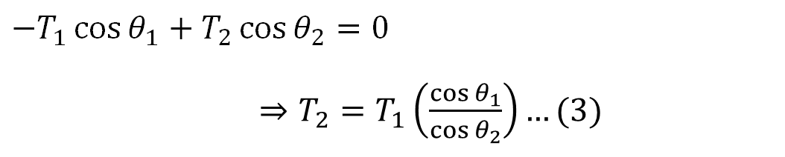
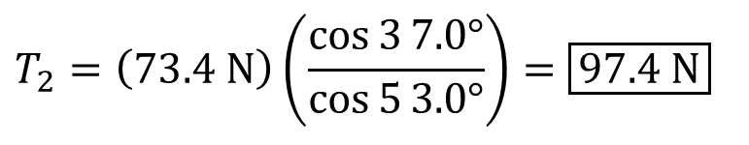
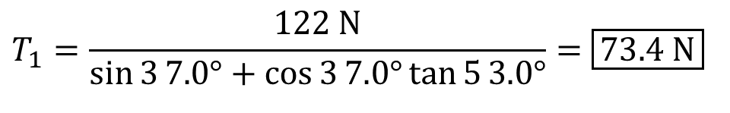
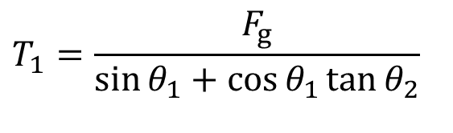
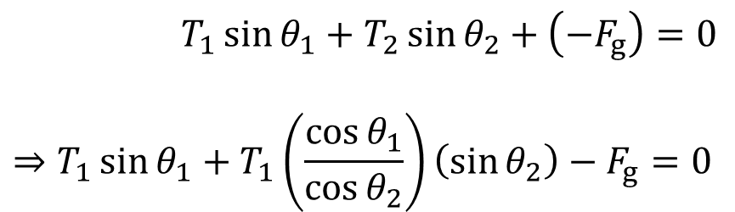
Example: Traffic Light
From equation (1)
$$−T_{1}\cos{θ_{1}}+T_{2}\cos{θ_{2}}=0$$
$⇒T_{2}=T_{1}\left(\frac{\cos{θ_{1}}}{\cos{θ_{2}}}\right)…(3)$
Substituting the value of T₂ from (3) into equation (2)
$T_{1}\sin{θ_{1}}+T_{2}\sin{θ_{2}}+\left(−F_{g}\right)=0$
$$⇒T_{1}\sin{θ_{1}}+T_{1}\left(\frac{\cos{θ_{1}}}{\cos{θ_{2}}}\right)\left(\sin{θ_{2}}\right)−F_{g}=0$$
$$T_{1}=\frac{F_{g}}{\sin{θ_{1}}+\cos{θ_{1}}\tan{θ_{2}}}$$
Substituting the value of T₁ into equation (3)
$$T_{1}=\frac{122\text{ N}}{\sin{3}7.0°+\cos{3}7.0°\tan{5}3.0°}=\boxed{73.4\text{ N}}$$
$$T_{2}=\left(73.4\text{ N}\right)\left(\frac{\cos{3}7.0°}{\cos{5}3.0°}\right)=\boxed{97.4\text{ N}}$$
Notes:
Solve Equation (1) for T₂ in terms of T₁.
Substitute this value for T₂ into Equation (2). [click to show equation]
Solve for T₁. [click to show equation]
Substitute numerical values. [click to show equation]
Using Equation (3), solve for T₂. [click to show equation]
Both values are less than 100 N ( just barely for T₂), so the cables will not break.

Slide 12
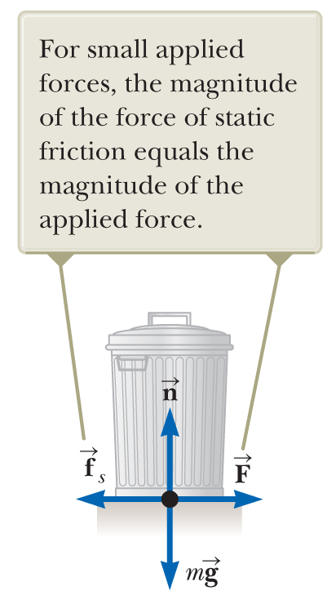
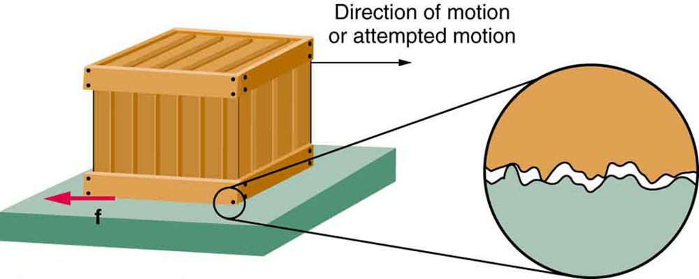

Force of Static Friction
Force of static friction f_{s}
As long as trash can not move f_{s} = F
    If F increases → f_{s} also increases
    If F decreases → f_{s} also decreases
Friction force arises from nature of the two surfaces and is always parallel to the surface.
Because of their roughness, contact made only at a few locations where peaks of material touch.
$\vec{N}$
Notes:
When object in motion on surface or in viscous medium (i.e., air, water) → resistance to motion because object interacts with surroundings
This resistance: force of friction
Friction important: allows us to walk or run and necessary for motion of wheeled vehicles
Imagine dragging full trash can across rough surface:
Apply external horizontal force F to right→ can remains stationary when F small
Force that counteracts F and keeps it from moving acts toward left: force of static friction f_{s}
As long as trash can not moving: f_{s} = F
If F increases → f_{s} also increases
If F decreases → f_{s} also decreases
Friction force arises from nature of the two surfaces:
Because of their roughness, contact made only at a few locations where peaks of material touch
At these locations friction force arises:
Because one peak physically blocks motion of peak from opposing surface
Chemical bonding (“spot welds”) of opposing peaks as they come into contact
Details of friction quite complex at atomic level → force ultimately involves electrical interaction between atoms or molecules

Slide 13
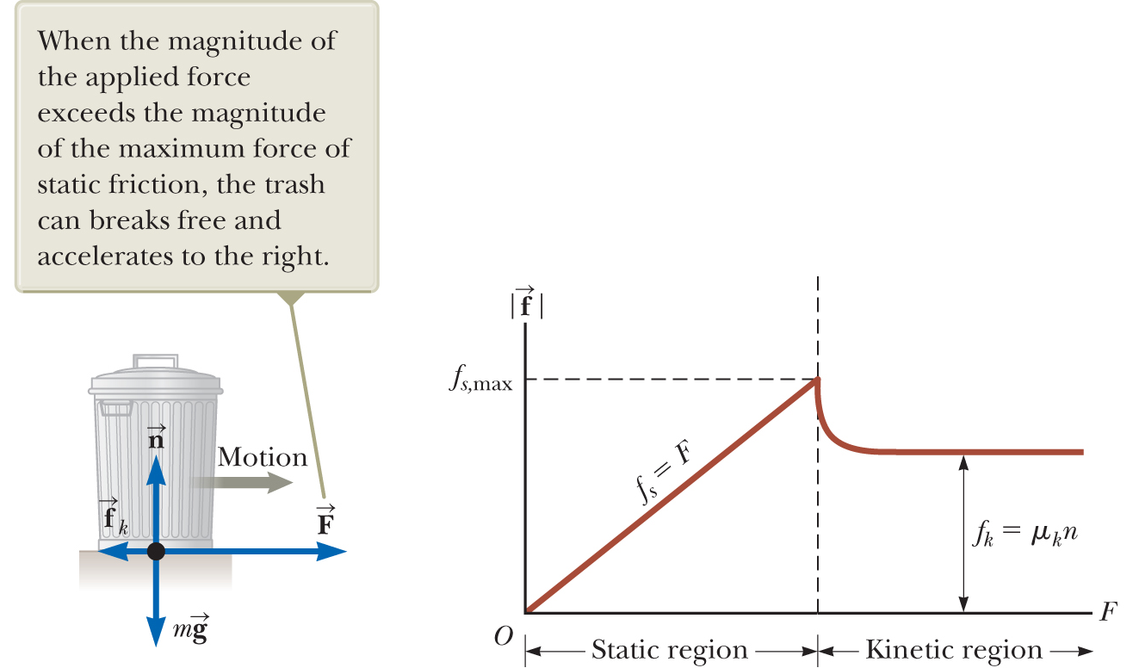


Force of Kinetic Friction
Force of Kinetic Friction
Friction force for object in motion: force of kinetic friction f_{k}
When trash can in motion: force of kinetic friction < f_{s,max}
$\vec{N}$
$$f_{k}=μ_{k}N$$
Notes:
Increase magnitude of F (left figure) → trash can eventually slips
When trash can on verge of slipping: f_{s} maximum value f_{s,max} (figure (b))
When F exceeds f_{s,max} trash can moves and accelerates to right
Friction force for object in motion: force of kinetic friction f_{k}
When trash can in motion: force of kinetic friction < f_{s,max}
Net force F − f_{k} in x direction produces acceleration to right (Newton’s second law)
If F = f_{k}, acceleration = 0 → trash can moves to right with constant speed
If applied force F removed → friction force f_{k} provides acceleration of trash can in −x direction →
eventually brings it to rest

Slide 14
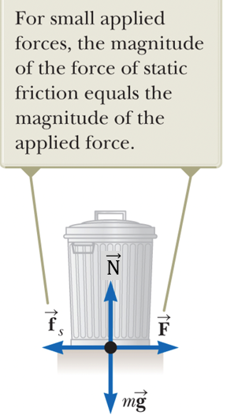
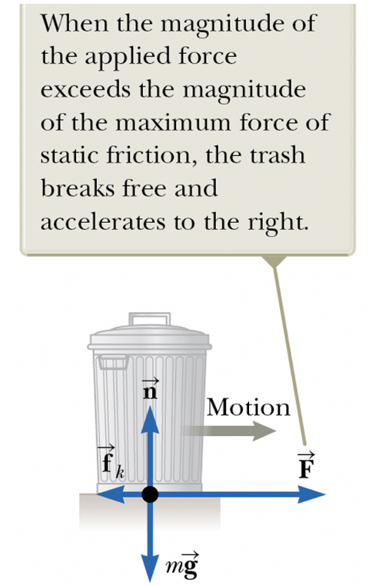
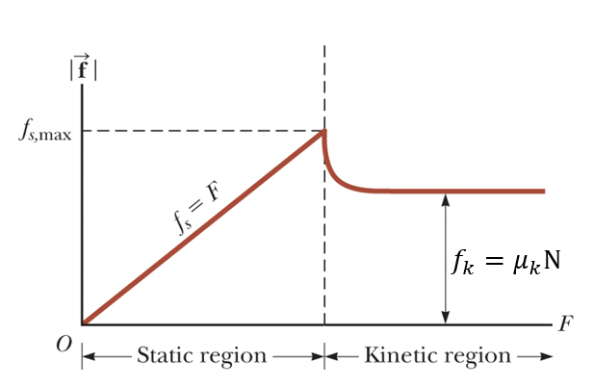
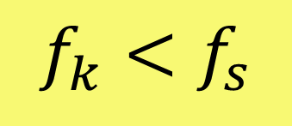

Two types of Frictional Forces
Two types of friction forces
Force of static Friction, also called starting friction, is when the object is about to START moving.
$\vec{N}$
Force of kinetic friction, also called sliding friction, is when the object is MOVING.
$$f_{k}<f_{s}$$

Slide 15

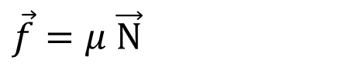

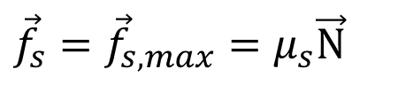
Coefficient of Friction
Static friction:
$${\vec{f}}_{s}≤μ_{s}\vec{N}$$
$${\vec{f}}_{s}={\vec{f}}_{s, max}=μ_{s}\vec{N}$$
Kinetic friction:
$${\vec{f}}_{k}=μ_{k}\vec{N}$$
$$\vec{f}=μ \vec{N}$$
μ_{s} = coefficient of static friction
μ_{k} = coefficient of kinetic friction
Values of μ_{k} and μ_{s} depend on nature of the surfaces, typical values: 0.03 to 1.0 → generally μ_{k} < μ_{s}
Direction of friction force parallel to surface and opposite to the actual motion (kinetic friction) or the impending motion (static friction) of the object relative to the surface.
Notes:
Experimentally, to a good approximation, both f_{s,max} and f_{k} ∝ magnitude of normal force exerted on object by surface
Simplification model for forces of friction (based on experiments):
Magnitude of static friction force between any two surfaces in contact: [click to show equation]
Dimensionless constant μ_{s} = coefficient of static friction
n = magnitude of normal force exerted by one surface on other
Equality holds when surfaces on verge of slipping → when [click to show equation]
Situation called impending motion
Inequality holds when surfaces not on verge of slipping
Magnitude of force of kinetic friction acting between two surfaces is: [click to show equation]
μ_{k} = coefficient of kinetic friction
Coefficient of kinetic friction can vary with speed → usually neglect
Values of μ_{k} and μ_{s} depend on nature of the surfaces → generally μ_{k} < μ_{s}
Typical values: 0.03 to 1.0
Direction of friction force parallel to surface and opposite to actual motion (kinetic friction) or impending motion (static friction) of object relative to surface
Coefficients of friction nearly independent of area of contact between surfaces
Might expect that placing object on side having most area might increase friction force → provides more points in contact
Weight spread out over larger area and individual points not pressed together as tightly
Effects approximately compensate →
friction force independent of area

Slide 16
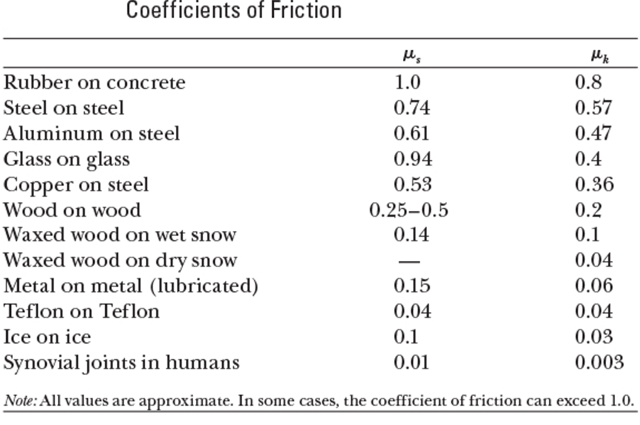
Coefficient of Friction
Coefficient of Friction
Coefficients of Friction

Slide 17
ABCD card
Is it harder to move a box is not moving or one that is already moving?
Not moving
Already moving
Doesn’t matter

Slide 18

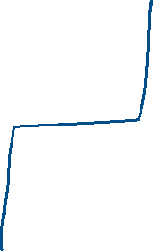


CQ #1
A 45 kg box initially rests on a horizontal surface. The coefficients of static friction and kinetic friction between the box and the surface are μ_{s} = 0.33 and μ_{k} = 0.30, respectively.
Now, a horizontal 140 N force is applied to push the box. What is the friction force acting on the box?
45 N
132 N
140 N
118 N

Slide 19
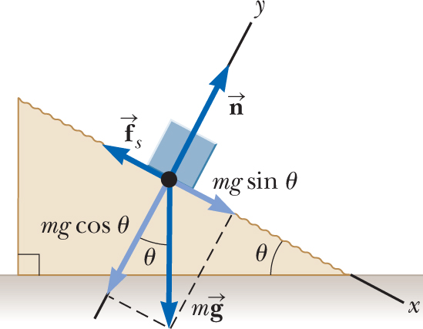

Experimental Determination of μ_{s} and μ_{k}
The following is a simple method of measuring coefficients of friction. Suppose a block is placed on a rough surface inclined relative to the horizontal as shown in the figure.
The incline angle is increased until the block starts to move. Show that you can obtain μ_{s} by measuring the critical angle θ_{c} at which this slipping just occurs.
$\vec{N}$
Notes:
Conceptualize Consider the figure and imagine that the block tends to slide down the incline due to the gravitational force. To simulate the situation, place a coin on a book’s cover and tilt the book until the coin begins to slide. Notice how this example differs than if there were no friction. When there is no friction on an incline, any angle of the incline will cause a stationary object to begin moving. When there is friction, however, there is no movement of the object for angles less than the critical angle.
Categorize The block is subject to various forces. Because we are raising the plane to the angle at which the block is just ready to begin to move but is not moving, we categorize the block as a particle in equilibrium.

Slide 20

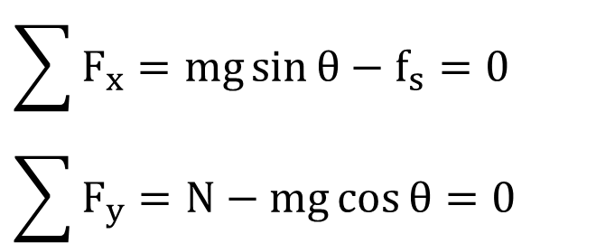


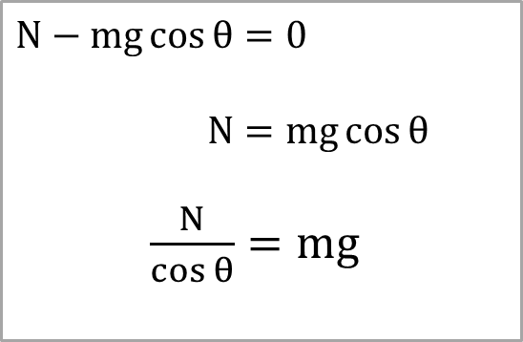
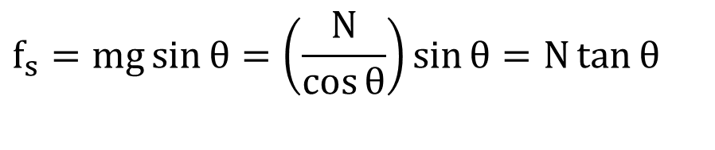

Experimental Determination of μ_{s} and μ_{k}
$$N−mg\cos{θ}=0$$
$N=mg\cos{θ}$
$\frac{N}{\cos{θ}}=mg$
$${\vec{f}}_{s}=μ_{s}\vec{N}$$
$$\sum{F_{x}}=mg\sin{θ}−f_{s}=0 \\ \sum{F_{y}}=N−mg\cos{θ}=0$$
$$f_{s}=mg\sin{θ}=\left(\frac{N}{\cos{θ}}\right)\sin{θ}=N\tan{θ}$$
$$μ_{s}N=N\tan{θ_{c}}$$
$\vec{N}$
$$μ_{s}=\tan{θ_{c}}$$
Notes:
Analyze The diagram shows the forces on the block: the gravitational force mg, the normal force n, and the force of static friction f_{s}. We choose x to be parallel to the plane and y perpendicular to it.
From the particle in equilibrium model, apply ΣF = 0 to the block in both the x and y directions. [click to show equations]
Substitute mg = n/cos θ. [Click to show equation]
When the incline angle is increased until the block is on the verge of slipping, the force of static friction has reached its maximum value μ_{s}n. The angle θ in this situation is the critical angle θ_{c}. Make these substitutions. [click to show equation]
We have shown, as requested, that the coefficient of static friction is related only to the critical angle.
Finalize Once the block starts to move at θ ≥ θ_{c}, it accelerates down the incline and the force of friction is f_{k} = μ_{k}n. If θ is reduced to a value less than θ_{c}, it may be possible to find an angle θ_{c}′ such that the block moves down the incline with constant speed as a particle in equilibrium again (a_{x} = 0). In this case, use our equilibrium equations with f_{s} replaced by f_{k} to find μ_{k}: μ_{k} = tanθ_{c}′, where θ_{c}′ < θ_{c} .

Slide 21
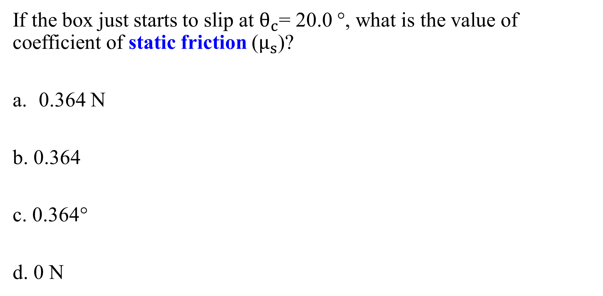


ABCD card
If the box just starts to slip at $θ_{c}$= 20.0 °, what is the value of coefficient of static friction ($μ_{s}$)?
0.364 N
b. 0.364
c. 0.364°
d. 0 N
$\vec{N}$
$${\vec{N}}_{max}=? \&{ \vec{N}}_{max}=??$$

Slide 22
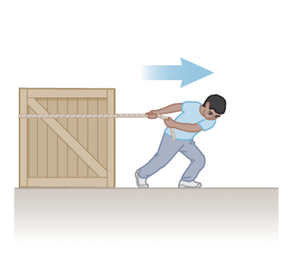
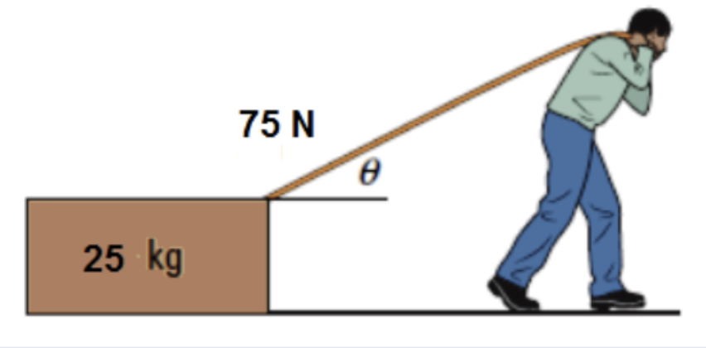
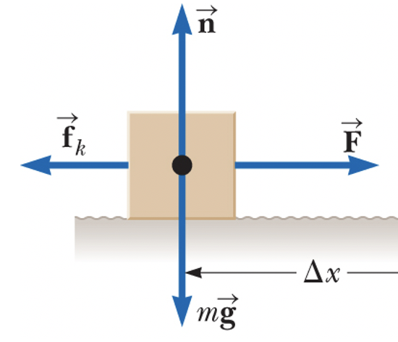
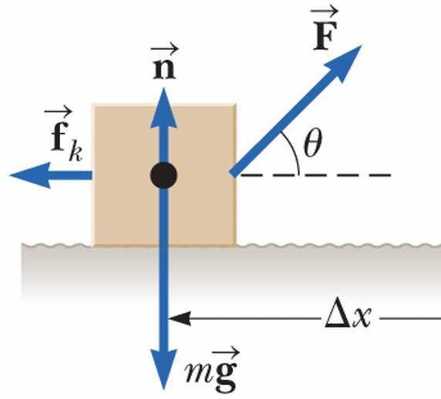




Example: Find the acceleration?
$$\vec{N}$$
$$\vec{T}$$
$$\vec{N}$$
$$\vec{T}$$

Slide 23



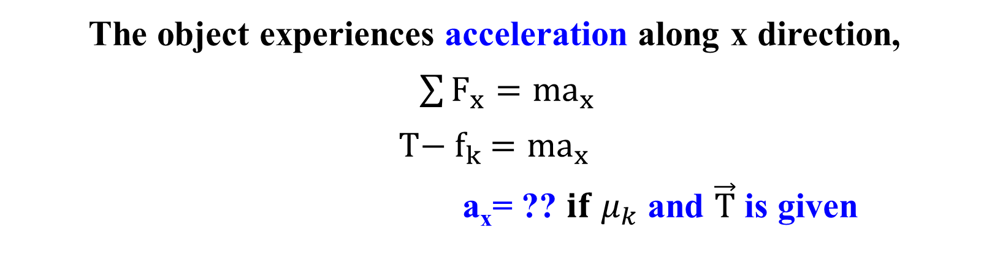

Example: Find the acceleration?
No acceleration along y direction,
$\sum{F_{y}}=0$
$N−F_{g}=0$
$$N=F_{g} =mg$$
The object experiences acceleration along x direction,
$\sum{F_{x}}=ma_{x}$
$$T{− f}_{k} =ma_{x}$$
a_{x}= ?? $if μ_{k}$ and $\vec{T}$ is given
$$\vec{N}$$
$${\vec{f}}_{k}=μ_{k}\vec{N}$$
$$\vec{T}$$

Slide 24




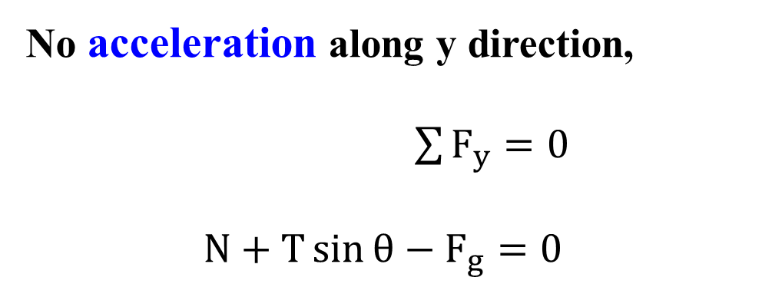

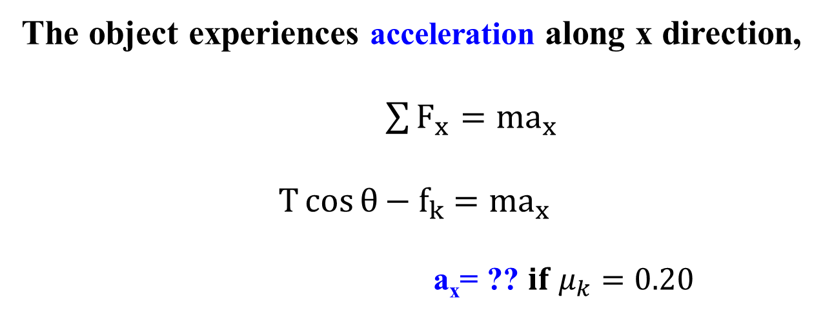


Example: Find the acceleration?
No acceleration along y direction,
$\sum{F_{y}}=0$
$$N+T\sin{θ}−F_{g}=0$$
$$\vec{T}$$
$$\vec{N}$$
$$N=F_{g}−T\sin{θ}$$
The object experiences acceleration along x direction,
$\sum{F_{x}}=ma_{x}$
$$T\cos{θ}{− f}_{k} =ma_{x}$$
a_{x}= ?? $if μ_{k}=0.20$
$$\vec{T}\sin{θ}$$
$$\vec{T}$$
$$\vec{N}$$
$${\vec{f}}_{k}=μ_{k}\vec{N}$$
$$\vec{T}\cos{θ}$$

Slide 25
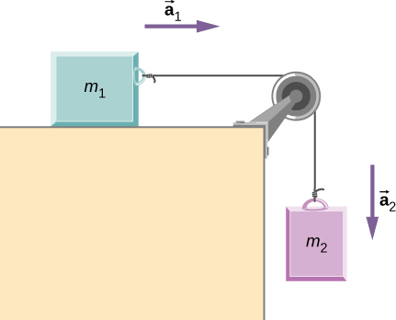
Problem Solving (Application of Newton’s Law)
Two blocks are connected by a massless rope as shown below. The mass of the block on the table is 4.00 kg and the hanging mass is 1.00 kg. The table and the pulley are frictionless.
Find the acceleration of the system.
(b) Find the tension in the rope.
(c) Find the speed with which the hanging
mass hits the floor if it starts from rest
and is initially located 1.00 m from the floor.
N
T
T
F_{g1}
F_{g2}

Slide 26
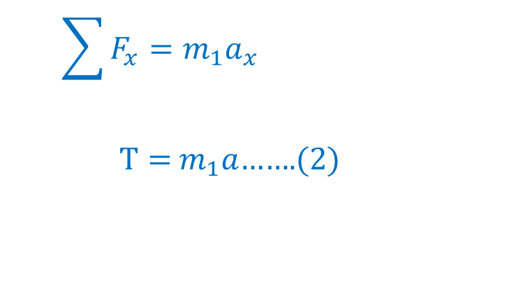
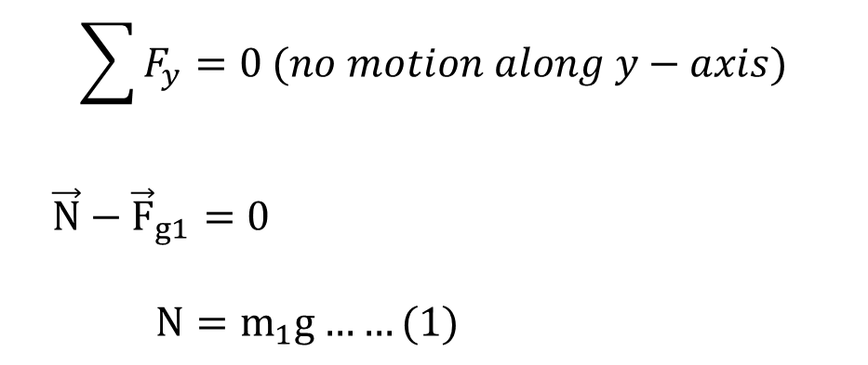
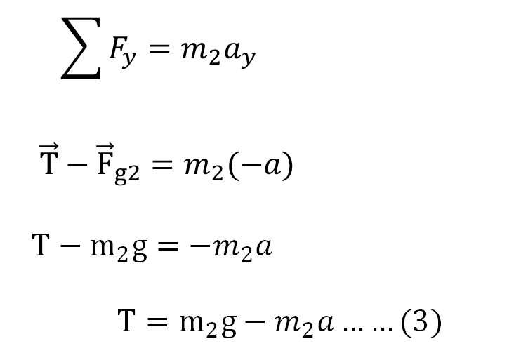


Problem Solving (Application of Newton’s Law)
N
$$\vec{a}$$
T
T
$$\vec{a}$$
F_{g1}
F_{g2}
$$\sum{F_{y}}=0 (no motion along y−axis)$$
$$\vec{N}−{\vec{F}}_{g1}=0$$
$$N=m_{1}g……(1)$$
$$\sum{F_{y}}=m_{2}a_{y}$$
$$\vec{T}−{\vec{F}}_{g2}=m_{2}(−a)$$
$$T−m_{2}g=−m_{2}a$$
$$T=m_{2}g−m_{2}a……(3)$$
$$\sum{F_{x}}=m_{1}a_{x}$$
$T=$ $m_{1}a$…….(2)

Slide 27





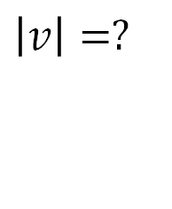
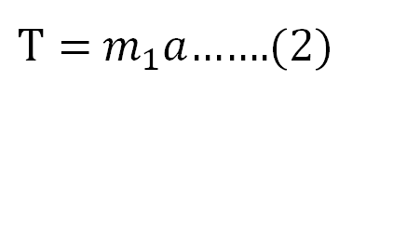









Problem Solving (Application of Newton’s Law)
$T=$ $m_{1}a$…….(2)
$$m_{2}$$
$$v_{0}=0$$
$$T=m_{2}g−m_{2}a……(3)$$
$$−1.0 m$$
$$\vec{a}$$
$$From equation \left(2\right)and \left(3\right)$$
$$m_{1}a=m_{2}g−m_{2}a$$
$$m_{1}a+m_{2}a=m_{2}g$$
$${a(m}_{1}+m_{2})=m_{2}g$$
$$m_{2}$$
$$v=?$$
$$Use kinematic equation to find speed$$
$$v^{2}={v_{0}}^{2}+2a(y−y_{0})$$
$$v^{2}=0+2(−1.96)(−1.00)$$
$$\left|v\right|=?$$
$$a=\frac{m_{2}g}{{(m}_{1}+m_{2})}=1.96m/s^{2}$$
$$From equation \left(2\right)$$
$T=$ $m_{1}a$= 7.84 N

Slide 28
Problem Solving (Application of Newton’s Law)
ii. Two blocks are connected by a massless rope as shown below. The mass of the block on the table is 4.00 kg and the hanging mass is 1.00 kg. If there is a coefficient of kinetic friction of 0.2 acting between the table and the mass m₁
Find the acceleration of the system.
N
T
f
T
F_{g1}
F_{g2}

Slide 29








$$\sum{F_{y}}=0 (no motion along y−axis)$$
$$\vec{N}−{\vec{F}}_{g1}=0$$
$$N=m_{1}g……(1)$$
$${\vec{f}}_{k}=μ_{k}\vec{N}$$
$$\vec{a}$$
N
f
T
T
$$\vec{a}$$
F_{g1}
$$\sum{F_{x}}=m_{1}a_{x}$$
$T−f=$ $m_{1}a$
$T−μ_{k}N=$ $m_{1}a$
$T−μ_{k}(m_{1}g)=$ $m_{1}a$ (from equation 1)
F_{g2}
$$\sum{F_{y}}=m_{2}a_{y}$$
$$\vec{T}−{\vec{F}}_{g2}=m_{2}(−a)$$
$$T−m_{2}g=−m_{2}a$$
$$T=m_{2}g−m_{2}a……(3)$$
$$T=m_{1}a+μ_{k}\left(m_{1}g\right)……(2)$$

Slide 30








Problem Solving (Application of Newton’s Law)
$T=m_{1}a+μ_{k}\left(m_{1}g\right)……(2)$
$$T=m_{2}g−m_{2}a……(3)$$
$$From equation \left(2\right)and (3)$$
$m_{1}a+μ_{k}\left(m_{1}g\right)=m_{2}g−m_{2}a$
$m_{1}a+m_{2}a=m_{2}g−μ_{k}\left(m_{1}g\right)$
${a(m}_{1}+m_{2})=m_{2}g−μ_{k}\left(m_{1}g\right)$
$$a=\frac{m_{2}g−μ_{k}\left(m_{1}g\right)}{{(m}_{1}+m_{2})}=…m/s^{2}$$

Slide 31



Problem Solving (Application of Newton’s Law)
iii. A friend of yours is trying to pull a cabinet into her office. The cabinet has a mass of 75.0 kg, and she can’t get it to budge on her own. You try to help and begin pushing horizontally in the same direction. Your friend is pulling with a force of 200 N at an angle θ = 25.0° above the horizontal. If the coefficient of static friction between the cabinet and the floor is μ_{s}​=0.40, what force must you exert (${\vec{F}}_{push}$) to just get it moving?
Answer: 79.0 N

Slide 32












Problem Solving (Application of Newton’s Law)
$${\vec{f}}_{s}≤μ_{s}\vec{N}$$
$$F_{pull}$$
$$F_{pull}\sin{θ}$$
$$θ$$
$$F_{pull}\cos{θ}$$
$$\sum{F_{x}}=F_{push}+F_{pull}\cos{θ}−f_{s,max}=0$$
$$\sum{F_{y}}=N+F_{pull}\sin{θ}−mg=0$$
$$F_{push}=f_{s,max}−F_{pull}\cos{θ…(1)}$$
$$N=mg−F_{pull}\sin{θ}$$
$$From \left(1\right) and (2)$$
$$f_{s,max}=μ_{s}N=μ_{s}\left(mg−F_{pull}\sin{θ}\right)…(2)$$
$$F_{push}=μ_{s}\left(mg−F_{pull}\sin{θ}\right)−F_{pull}\cos{θ}$$
$$F_{push}=____ N$$

Slide 33



Spring Force
Spring Force (recall…)
Springs come in in many forms. When deflected, they push or pull with a spring force.
Hooke’s law:
F_{s} = spring force
k = spring constant
x = spring stretch or compression
Restoring force → always directed toward equilibrium position.

Slide 34






Problem Solving (Spring Force)
As shown in the figure a 30.0 kg block is resting on a frictionless ramp inclined at 60° to the horizontal. The block is held by a spring that is stretched 5.0 cm. What is the spring constant of the spring?
Hooke’s law:
$$F_{s}$$
$$F_{s}=−kx$$
$$mg\sin{θ}=kx$$
$$mg\sin{θ}$$
$$k≈5092 N/m$$

Slide 35



Problem Solving (Spring Force)
A block of mass m = 10.0 kg is at rest on a frictionless inclined plane with angle θ = 30°. It is attached to an extended spring with spring constant k = 330 N/m on the higher end of the inclined plane and with a taut rope with tension T = 50.0 N at the other end, as shown in the figure. How long is the spring extended long is the spring extended relative to its relaxed length?
Answer: 0.30 m
$$F_{s}$$
$$Mg\sin{θ}$$

Slide 36











Problem Solving (Spring Force)
$$\sum{F_{x}}=T+F_{g}\sin{θ}−F_{sp}=0$$
$$\vec{N}$$
Spring force, $F_{sp}=kx$
$$F_{sp}=T+F_{g}\sin{θ}$$
$$kx=T+mg\sin{θ}$$
$$\sum{F_{y}}=N{− F}_{g}\cos{θ}=0$$
$$x=___ m$$
$$N=F_{g}\cos{θ}=mg\cos{θ}$$
$${\vec{N}}_{max}=? \& {\vec{N}}_{max}=??$$

Slide 37


Summary: Applying Newton’s Laws
Equilibrium Problems
Dynamics Problems
Use kinematics to find velocities and positions.
Find out force or mass.
Notes:
Imagine an object that can be modeled as a particle. If it has several forces acting on it so that the forces all cancel, giving a net force of zero, the object will have an acceleration of zero. This condition is mathematically described as: [click to show equation]
Imagine an object that can be modeled as a particle. If it has one or more forces acting on it so that there is a net force on the object, it will accelerate in the direction of the net force. The relationship between the net force and the acceleration is: [click to show equation]

Slide 38



Summary: Applying Newton’s Laws
Single Object Problems
$\vec{N}$
+
kinematics equations

Slide 39




Summary: Applying Newton’s Laws
Summary: Applying Newton’s Laws
Two connected object Problems
(1) Draw a free-body diagram for each object;
(2) Tension force has the same magnitude throughout the rope;
(3) Move together → the magnitude of acceleration is the same.

Slide 40
Summary: Applying Newton’s Laws
Newton’s 1st & 2nd Laws
  Draw and interpret a free-body diagram.
  Describe the consequences of no force or balanced forces on an object.
  Write Newton’s 2nd Law for a physical scenario.
  Use Newton’s 2nd Law to solve a problem
    With balanced forces.
    With unbalanced forces.
  Use Newton’s Laws to predict the motion of an object.
More forces & Newton’s 3rd Law
  Use Newton’s 3rd Law to identify force pairs.
  Solve problems involving static friction, kinetic friction, gravity, tension, and normal force.

